Slide 1
OSIRIS
By Matthew Lord

Slide 2
History of OSIRIS
Osiris is told to be one of five children born to the God of Earth and Goddess of the Skies.
Geb and Nut are the names of his parents.
Osiris is also the great-grandson of one of the most popular Egyptian gods, Re.

Slide 3
Osiris’ Siblings
Osiris had three younger siblings.
1. His brother Seth.
2. Sisters Isis and Nephthys.
Osiris as the first born son, it therefore fell on him to inherit the throne of Egypt.

Slide 4
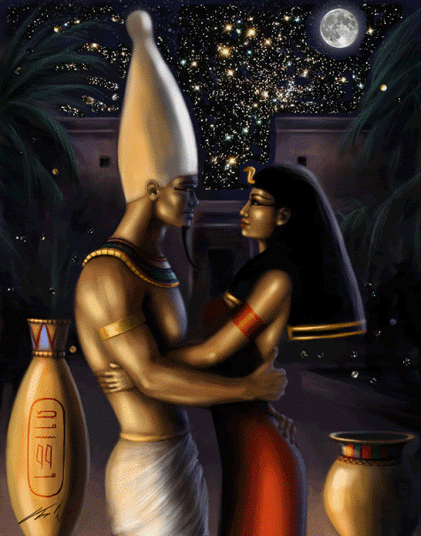
Marriage of the Gods
Seth married Nephthys and Osiris married Isis.
Osiris and Isis seemed to have possession of numerous powers. Their marriage was not destined to be happy!

Slide 5
Misconception
Nephthys appears to have magically taken on the appearance of Isis and presented herself to Osiris as his wife. Osiris not knowing, was seduced by Nephthys and she became pregnant and gave birth to Anubis.

Slide 6
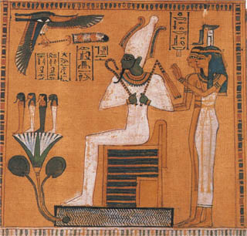
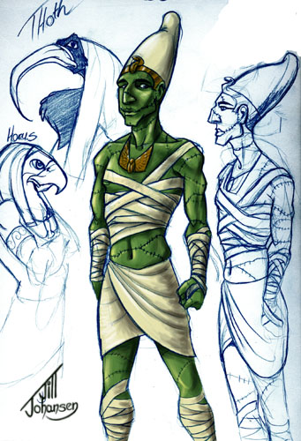
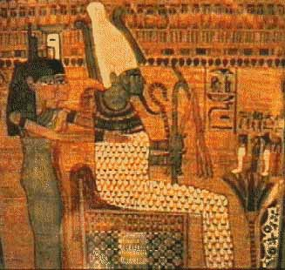
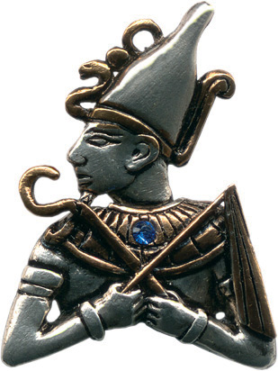
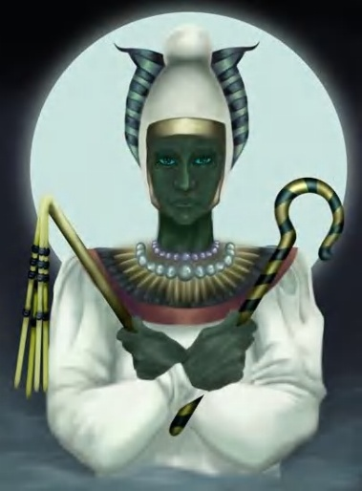
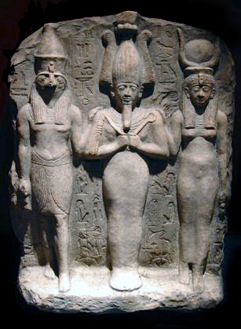
OSIRIS

Slide 7
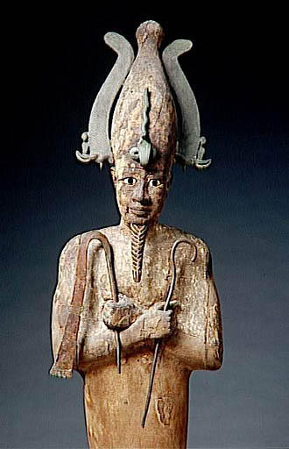
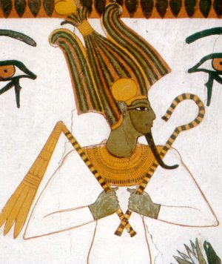
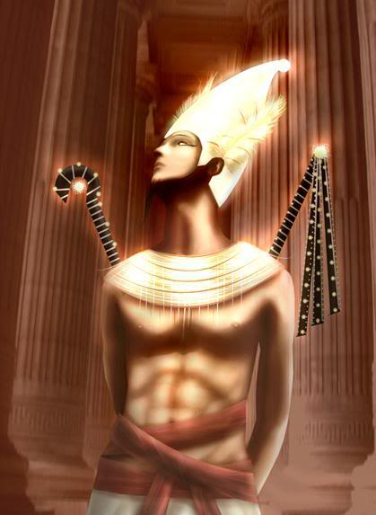
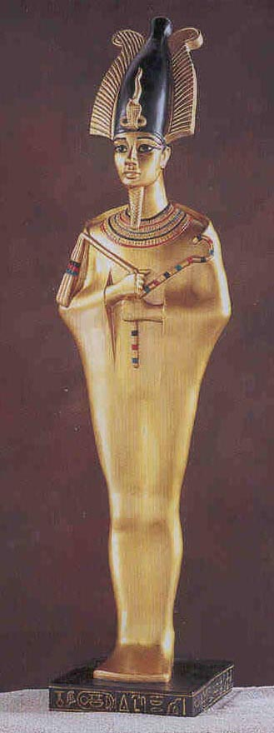
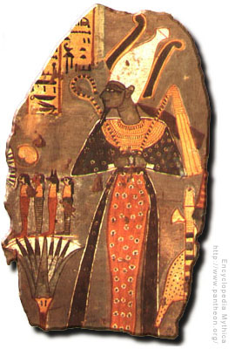
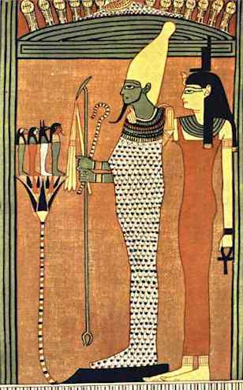
OSIRIS

Slide 8
Killing of Osiris
Seth did not like his brother and sought to kill him by luring him into a coffin and drowning him in the Nile.
The annual flooding of the Nile River is still thought to be representative of this event.
Isis recovered her husband’s body. Seth stole it and cut up the body of the Egyptian god of the underworld.
Seth hid the pieces throughout the Egyptian desert.

Slide 9
Magical Powers
Isis spent many years searching for the mutilated body parts of her husband Osiris.
She found all of the pieces, and believed to have used her magical powers to restore her husband’s body.
Having used her magical powers to bring back her husband, she became pregnant and gave birth to a son, Horus.

Slide 10
Osiris to the Underworld
Osiris righfully obtained the important role as Egyptian god of the underworld because he was the first god to have died.
It became Osiris’ responsibility to judge the souls of the dead.
Osiris remained as one of the most popular of all the ancient Egyptian gods.

Slide 11
Set
In Ancient Egyptian mythology Set(also Seth, Sutekh or Seteh) is an ancient god.
He was originally the god of the desert, storms, darkness and chaos.

Slide 12
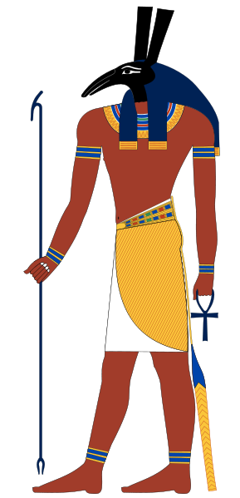
Origins of name
The exact origin of Set is unknown.
It is sometimes considered to be either (one who) dazzles or Pillar of stability.

Slide 13
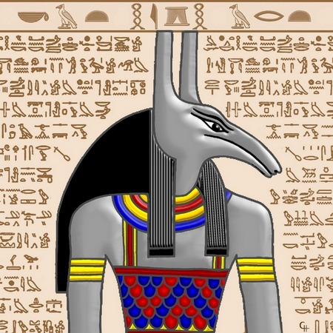
Desert god
Set was the god of the desert and chaos.
He was viewed as very powerful.
Set was sometimes referred to as “His Majesty”

Slide 14
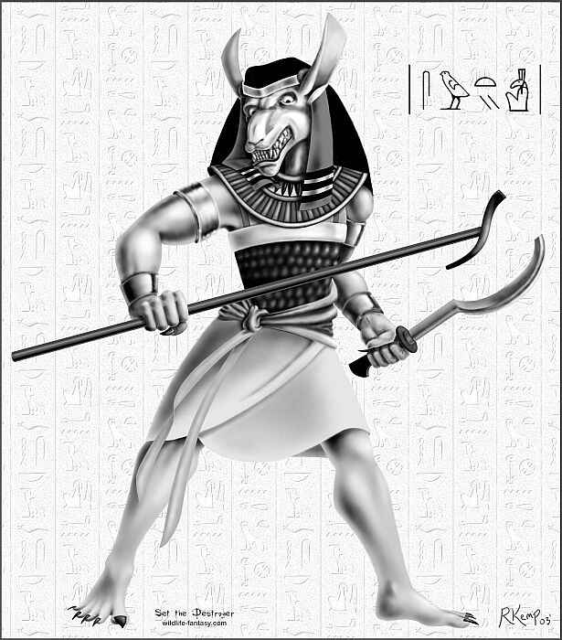
The Set animal
In art, Set was known as mysterious , as the Set animal or beast.
He had a curved snout, square ears, forked tail, and canine body.
We would think of it today as a aardvark, donkey or jackal.

Slide 15
Picture references
http://www.phoenician.org/isis-osiris2-small.jpg
http://www.heathensent.com/gallery/osiris.jpg
http://www.crystalinks.com/osiris3.gif
http://allthingsmysticalandmagical.com/images/products/ja16_osiris.jpg
http://spells-witchcraft.org/Pictures-of-Goddesses-Gods/osiris.jpg
http://www.ancientsculpturegallery.com/images/206.jpg
http://www.culture.gouv.fr/documentation/archeos/dieux/osiris_gf.jpg
http://www.pantheon.org/areas/gallery/mythology/africa/egyptian/osiris.jpg
http://www.biasci.com/polyorg/Osiris_idol.jpg
http://images2.wikia.nocookie.net/uncyclopedia/images/6/6a/Set_egyptian_god.jpg

Slide 16
Picture and Information references
http://media.photobucket.com/image/osiris/markgoopio/Osiris_by_MonicaWeasley.jpg
http://media.photobucket.com/image/osiris,%20isis/Cristy66france/Osiris_and_Isis_small-copia.gif
http://web.ukonline.co.uk/gavin.egypt/images/pa16.jpg
http://maratray.chez-alice.fr/images/religion/egypte/osiris.jpg
http://www.ancient-egypt-online.com/osiris.html
http://en.wikipedia.org/wiki/Set_(mythology)
http://thumbs.imagekind.com/member/7e74afbc-9a03-4a93-88ef-cacc8e90d620/uploadedartwork/450X450/3ed74933-4566-4ca4-acf2-6535c704df43.jpg
http://upload.wikimedia.org/wikipedia/commons/thumb/7/7a/Set.svg/289px-Set.svg.png

