Slide 1
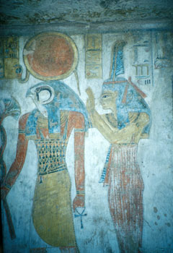
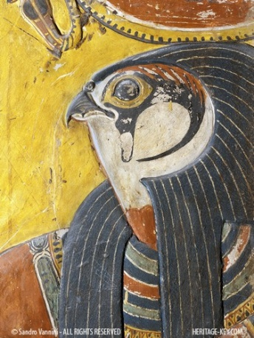
My Egyptian Gods
Horus and Re

Slide 2
Horus
Son of Osiris and Isis
God of the sky
Had the head of a hawk
Well-known for being protector and ruler of Egypt
Egyptians believed the pharaoh was the living Horus
Horus fought Seth for the throne of Egypt because Seth murdered Osiris
Horus lost an eye in the battle

Slide 3
Horus (cont.)
The eye became a sign of protection for Egypt
Horus was picked as Egypt’s ruler of the living
Horus means “The one far above”
Horus’s right eye represented the sun and his left eye represented the moon
Horus was shown as a boy sucking his finger seated on his mom’s lap when he was young
When he was an adult, he was shown as a falcon flying over the pharaoh

Slide 4
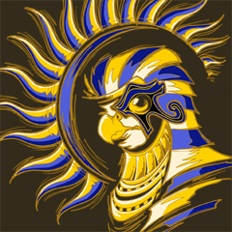
Re
God of the sun
Had the head of a hawk and a sun disk headdress
One of the most important Egyptian gods
Egyptians believed the sky goddess Nut ate Re every night, and Re came back every morning
They also believed Re travelled the underworld at night with a ram head
Re means sun
Amun-Re, king of all gods, was a combination of Amun and Re

Slide 5
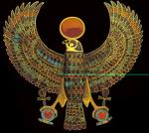
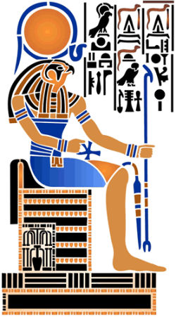
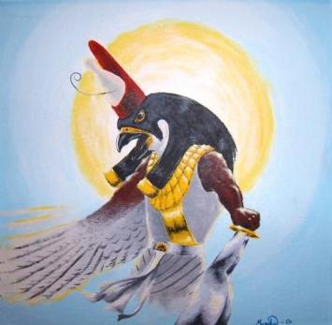
Re-Horakhty
Same appearance as Re
God of the rising sun
Was a combination of Re and Horus
Re-Horakhty means Horus in the horizon
Re
Re-Horakhty
Horus

